Slide 1
An Evaluation of D.C. Microsoft Imagine Academies
Whitney Wilson
University of Maryland, College Park
May 17, 2017

Slide 2
Overview
Background
Research Questions
Methodology
Data Analysis
Identified Barriers
Recommendations

Slide 3

Background
The Microsoft Imagine Academy program is a technology education curriculum that teaches students how to use Microsoft Office software and improves their computer literacy skills
The Office of the State Superintendent of Education offers the program at 20 traditional and adult high schools

Slide 4
Certifications
Microsoft Office Specialist (MOS): demonstrates mastery of Microsoft Office skills in one of the following applications: Word, PowerPoint, Excel, Access, OneNote, Sharepoint, Office 365 , and Outlook
Microsoft Technology Associate (MTA): indicates understanding of basic concepts in software development and information technology
Notes:
Currently, the DC MIA only offers the MOS certification
There are also the Microsoft Certified Solutions Associate and the Microsoft Certified Solutions Developer certifications which are higher technology certifications and are targeted towards post-secondary students and professionals, although it is not impossible for a student to earn them

Slide 5
Research Questions
What student, institution, and program level barriers exist to diversifying the types of credentials offered? How can OSSE help address those barriers?
Should OSSE expand the Microsoft Imagine Academy program to allow students to earn higher levels of Microsoft certifications?

Slide 6
Methodology
Teacher Surveys
Interviews with CTE Staff
Administered to D.C. CTE teachers during OSSE sponsored professional development training
15 teachers representing 9 schools
Conducted phone interviews with 8 individuals from:
North Carolina
Virginia
Georgia
Arizona
Washington

Slide 7
45.9%
87
6
12.3%
Average Exam Passage Rate
Average Exam Attempts Per School
Schools with <50% Passage Rates
Percent of total available exams used in 2015-2016

Slide 8
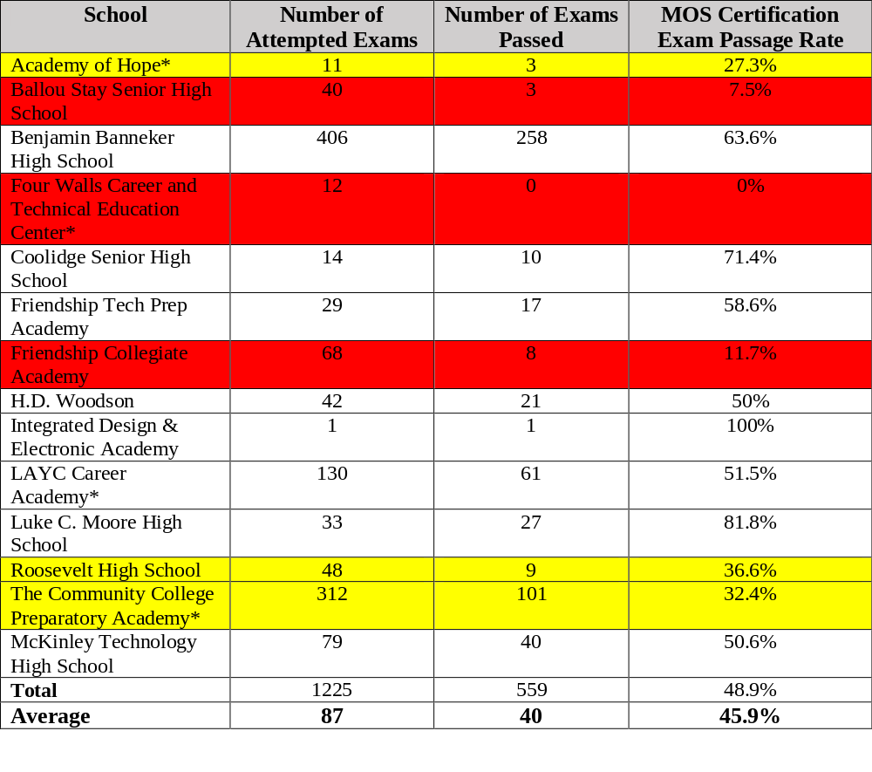
Notes:
Red indicates an exam passage rate of <25% and yellow indicates a passage rate greater than 25% and less than 50%
Two schools, CC prep and Banneker, contributed more than 64% of the exam attempts and certifications earned

Slide 9
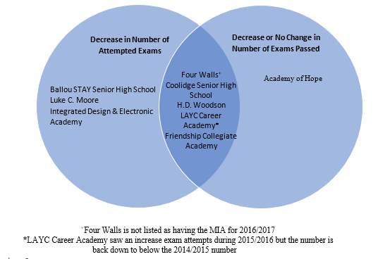
Notes:
Data from 2014/2015 – 2016/2017 school year
schools included had to have data on the number of exams attempted and number of exams passed for at lease two consecutive school years
5 schools have not improved the quality of their program in a way that would improve their exam outcomes

Slide 10
5%
Percent of eligible high school students who earn certification from Microsoft Imagine Academies
Notes:
Percentage based on published data of number of students in dc public schools in grades 9-12 during 2015-2016 school year
Conducted similar analysis for North Carolina, Washington state, and Virginia. DC was on par with Virginia in terms of % of eligible students earning certifications ( Virginia = 4.4%.. Both states lagged behind North Carolina and Washington who boast 11.4% and 7.3% respectively

Slide 11
Student Level Barriers
Behavioral based characteristics such as lack of motivation, self-discipline, poor time management and study habits
Institution Level Barriers
Microsoft Imagine Academy curriculum not integrated into Career and Technical Education courses
Few participants at most schools
Teacher buy in, administration buy in, IT support availability and reliability
Up to date technology resources i.e. software, computers
Notes:
Institution level refers to the individual school level. Not all of the barriers identified were present in all schools but they should be considered

Slide 12
Program Level Barriers
Not fully utilizing program data to inform improvements
Low student participation rate across the city
Lack of annual report and program analysis
Outdated website and lack of centrally located information

Slide 13
Do Not Expand to Offer Higher Certifications
Weaknesses in the organzation of the current program need to be addressed first
Insufficient progress in program improvements to better achieve programmatic goal
Lack of consistent program evaluation
Notes:
It is not a question of whether or not MTA exam would be useful. Research and literature have consistently stated that more advanced computer skills will be useful for the workforce. However, after evaluating the data of DC’s program and comparing it to the other states I have interviewed, I cannot recommend that OSSE expands the program to offer Higher Certifications
The website states that the goal of the program is to certify all of your students so they have a globally recognized technology certification before they progress into college or their career
I am not confident that the higher certification exams would be used
What is the desired passing rate?

Slide 14
If OSSE Decides to Offer MTA Certification
Integrate MTA certification into NAF program
Purchase set number of exams that can be allocated to schools based on request
Determine how many teachers have the background and qualifications needed to teach the upper level courses
Notes:
This is the Method that Washington state utilized
I was able to get data on 6 schools and on average there were 2 MIA teachers per school. Lack of qualified teachers could be a barrier to expansion

Slide 15
Additional Recommendations
Increase student participation
Update website
Consider adopting peer teacher training model
Annual Reporting

Slide 16
Special Thanks
Jason Wojcik
Dwayne Hobbs
Delda Hagin
Linda Lay
Jennifer Tyndall
Jennifer Metcalfe
Lance Qrzesinksi
Elizabeth Iaukea
Everyone at OSSE

Slide 17

Questions

Slide 18
Sources
- CCI Learning. Washington DC Microsoft Imagine Academy September 2016-April 2017 update
- Microsoft Imagine Academy Program Benefits, https://www.microsoft.com/en-us/education/imagine-academy/program-benefits/default.aspx
-

